Slide 1
Data Mining:
Concepts and Techniques
— Slides for Textbook —
— Chapter 6 —
©Jiawei Han and Micheline Kamber
Intelligent Database Systems Research Lab
School of Computing Science
Simon Fraser University, Canada
http://www.cs.sfu.ca
Data Mining: Concepts and Techniques

Slide 2
Chapter 6: Mining Association Rules in Large Databases
Association rule mining
Mining single-dimensional Boolean association rules from transactional databases
Summary
Data Mining: Concepts and Techniques

Slide 3
What Is Association Mining?
Association rule mining:
  Finding frequent patterns, associations, correlations, or causal structures among sets of items or objects in transaction databases, relational databases, and other information repositories.
Applications:
  Basket data analysis, cross-marketing, catalog design, loss-leader analysis, clustering, classification, etc.
Examples.
  Rule form: “Body → Ηead [support, confidence]”.
  buys(x, “diapers”) → buys(x, “beers”) [0.5%, 60%]
  major(x, “CS”) ^ takes(x, “DB”) → grade(x, “A”) [1%, 75%]
Data Mining: Concepts and Techniques

Slide 4
Association Rule: Basic Concepts
Given: (1) database of transactions, (2) each transaction is a list of items (purchased by a customer in a visit)
Find: all rules that correlate the presence of one set of items with that of another set of items
  E.g., 98% of people who purchase tires and auto accessories also get automotive services done
Applications
  * ⇒ Maintenance Agreement (What the store should do to boost Maintenance Agreement sales)
  Home Electronics ⇒ * (What other products should the store stocks up?)
  Attached mailing in direct marketing
  Detecting “ping-pong”ing of patients, faulty “collisions”
Data Mining: Concepts and Techniques

Slide 5
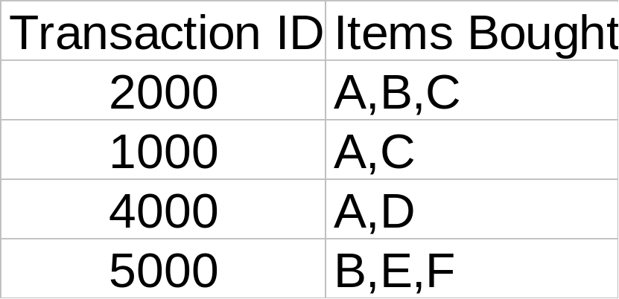
Rule Measures: Support and Confidence
Customer
buys both
Customer
buys diaper
Find all the rules X & Y ⇒ Z with minimum confidence and support
  support, s, probability that a transaction contains {X  Y  Z}
  confidence, c, conditional probability that a transaction having {X  Y} also contains Z
Customer
buys beer
Let minimum support 50%, and minimum confidence 50%, we have
  A ⇒ C (50%, 66.6%)
  C ⇒ A (50%, 100%)
Data Mining: Concepts and Techniques

Slide 6
Association Rule Mining: A Road Map
Boolean vs. quantitative associations (Based on the types of values handled)
  buys(x, “SQLServer”) ^ buys(x, “DMBook”) → buys(x, “DBMiner”) [0.2%, 60%]
  age(x, “30..39”) ^ income(x, “42..48K”) → buys(x, “PC”) [1%, 75%]
Single dimension vs. multiple dimensional associations (see ex. Above)
Single level vs. multiple-level analysis
  What brands of beers are associated with what brands of diapers?
Various extensions
  Correlation, causality analysis
    Association does not necessarily imply correlation or causality
  Maxpatterns and closed itemsets
  Constraints enforced
    E.g., small sales (sum < 100) trigger big buys (sum > 1,000)?
Data Mining: Concepts and Techniques

Slide 7
Chapter 6: Mining Association Rules in Large Databases
Association rule mining
Mining single-dimensional Boolean association rules from transactional databases
Summary
Data Mining: Concepts and Techniques

Slide 8
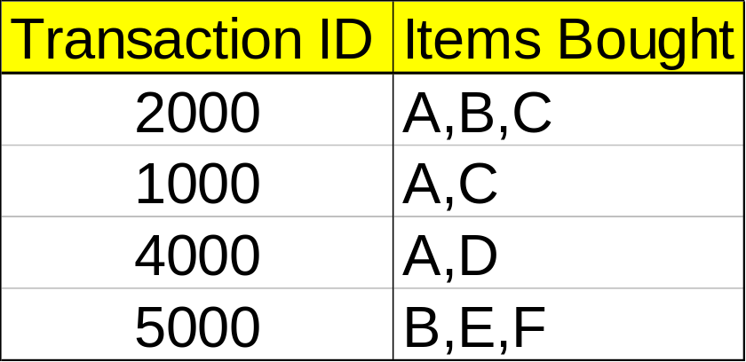
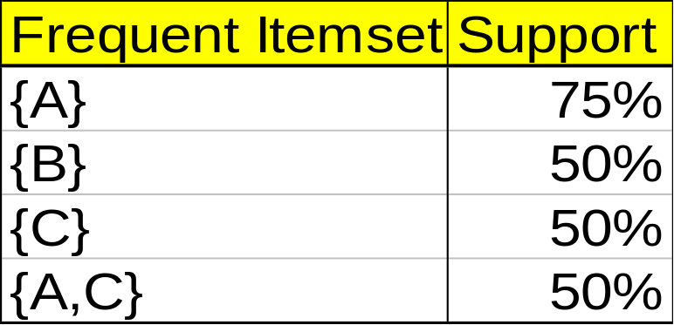
Mining Association Rules—An Example
Min. support 50%
Min. confidence 50%
For rule A ⇒ C:
  support = support({A C}) = 50%
  confidence = support({A C})/support({A}) = 66.6%
The Apriori principle:
  Any subset of a frequent itemset must be frequent
Data Mining: Concepts and Techniques

Slide 9
Mining Frequent Itemsets: the Key Step
Find the frequent itemsets: the sets of items that have minimum support
  A subset of a frequent itemset must also be a frequent itemset
    i.e., if {AB} is a frequent itemset, both {A} and {B} should be a frequent itemset
  Iteratively find frequent itemsets with cardinality from 1 to k (k-itemset)
Use the frequent itemsets to generate association rules.
Data Mining: Concepts and Techniques

Slide 10
The Apriori Algorithm
Join Step: C_{k} is generated by joining L_{k-1}with itself
Prune Step: Any (k-1)-itemset that is not frequent cannot be a subset of a frequent k-itemset
Pseudo-code:
    C_{k}: Candidate itemset of size k
    L_{k} : frequent itemset of size k
    L₁ = {frequent items};
    for (k = 1; L_{k} !=∅; k++) do begin
    C_{k+1} = candidates generated from L_{k};
    for each transaction t in database do
      increment the count of all candidates in C_{k+1} that are contained in t
    L_{k+1} = candidates in C_{k+1} with min_support
    end
    return ∪_{k} L_{k};
Data Mining: Concepts and Techniques

Slide 11








The Apriori Algorithm — Example
Database D
L₁
C₁
Scan D
C₂
C₂
L₂
Scan D
C₃
Scan D
L₃
Data Mining: Concepts and Techniques

Slide 12
References
R. Agarwal, C. Aggarwal, and V. V. V. Prasad. A tree projection algorithm for generation of frequent itemsets. In Journal of Parallel and Distributed Computing (Special Issue on High Performance Data Mining), 2000.
R. Agrawal, T. Imielinski, and A. Swami. Mining association rules between sets of items in large databases. SIGMOD'93, 207-216, Washington, D.C.
R. Agrawal and R. Srikant. Fast algorithms for mining association rules. VLDB'94 487-499, Santiago, Chile.
R. Agrawal and R. Srikant. Mining sequential patterns. ICDE'95, 3-14, Taipei, Taiwan.
R. J. Bayardo. Efficiently mining long patterns from databases. SIGMOD'98, 85-93, Seattle, Washington.
S. Brin, R. Motwani, and C. Silverstein. Beyond market basket: Generalizing association rules to correlations. SIGMOD'97, 265-276, Tucson, Arizona.
S. Brin, R. Motwani, J. D. Ullman, and S. Tsur. Dynamic itemset counting and implication rules for market basket analysis. SIGMOD'97, 255-264, Tucson, Arizona, May 1997.
K. Beyer and R. Ramakrishnan. Bottom-up computation of sparse and iceberg cubes. SIGMOD'99, 359-370, Philadelphia, PA, June 1999.
D.W. Cheung, J. Han, V. Ng, and C.Y. Wong. Maintenance of discovered association rules in large databases: An incremental updating technique. ICDE'96, 106-114, New Orleans, LA.
M. Fang, N. Shivakumar, H. Garcia-Molina, R. Motwani, and J. D. Ullman. Computing iceberg queries efficiently. VLDB'98, 299-310, New York, NY, Aug. 1998.
Data Mining: Concepts and Techniques

Slide 13
References (2)
G. Grahne, L. Lakshmanan, and X. Wang. Efficient mining of constrained correlated sets. ICDE'00, 512-521, San Diego, CA, Feb. 2000.
Y. Fu and J. Han. Meta-rule-guided mining of association rules in relational databases. KDOOD'95, 39-46, Singapore, Dec. 1995.
T. Fukuda, Y. Morimoto, S. Morishita, and T. Tokuyama. Data mining using two-dimensional optimized association rules: Scheme, algorithms, and visualization. SIGMOD'96, 13-23, Montreal, Canada.
E.-H. Han, G. Karypis, and V. Kumar. Scalable parallel data mining for association rules. SIGMOD'97, 277-288, Tucson, Arizona.
J. Han, G. Dong, and Y. Yin. Efficient mining of partial periodic patterns in time series database. ICDE'99, Sydney, Australia.
J. Han and Y. Fu. Discovery of multiple-level association rules from large databases. VLDB'95, 420-431, Zurich, Switzerland.
J. Han, J. Pei, and Y. Yin. Mining frequent patterns without candidate generation. SIGMOD'00, 1-12, Dallas, TX, May 2000.
T. Imielinski and H. Mannila. A database perspective on knowledge discovery. Communications of ACM, 39:58-64, 1996.
M. Kamber, J. Han, and J. Y. Chiang. Metarule-guided mining of multi-dimensional association rules using data cubes. KDD'97, 207-210, Newport Beach, California.
M. Klemettinen, H. Mannila, P. Ronkainen, H. Toivonen, and A.I. Verkamo. Finding interesting rules from large sets of discovered association rules. CIKM'94, 401-408, Gaithersburg, Maryland.
Data Mining: Concepts and Techniques

Slide 14
References (3)
F. Korn, A. Labrinidis, Y. Kotidis, and C. Faloutsos. Ratio rules: A new paradigm for fast, quantifiable data mining. VLDB'98, 582-593, New York, NY.
B. Lent, A. Swami, and J. Widom. Clustering association rules. ICDE'97, 220-231, Birmingham, England.
H. Lu, J. Han, and L. Feng. Stock movement and n-dimensional inter-transaction association rules. SIGMOD Workshop on Research Issues on Data Mining and Knowledge Discovery (DMKD'98), 12:1-12:7, Seattle, Washington.
H. Mannila, H. Toivonen, and A. I. Verkamo. Efficient algorithms for discovering association rules. KDD'94, 181-192, Seattle, WA, July 1994.
H. Mannila, H Toivonen, and A. I. Verkamo. Discovery of frequent episodes in event sequences. Data Mining and Knowledge Discovery, 1:259-289, 1997.
R. Meo, G. Psaila, and S. Ceri. A new SQL-like operator for mining association rules. VLDB'96, 122-133, Bombay, India.
R.J. Miller and Y. Yang. Association rules over interval data. SIGMOD'97, 452-461, Tucson, Arizona.
R. Ng, L. V. S. Lakshmanan, J. Han, and A. Pang. Exploratory mining and pruning optimizations of constrained associations rules. SIGMOD'98, 13-24, Seattle, Washington.
N. Pasquier, Y. Bastide, R. Taouil, and L. Lakhal. Discovering frequent closed itemsets for association rules. ICDT'99, 398-416, Jerusalem, Israel, Jan. 1999.
Data Mining: Concepts and Techniques

Slide 15
References (4)
J.S. Park, M.S. Chen, and P.S. Yu. An effective hash-based algorithm for mining association rules. SIGMOD'95, 175-186, San Jose, CA, May 1995.
J. Pei, J. Han, and R. Mao. CLOSET: An Efficient Algorithm for Mining Frequent Closed Itemsets. DMKD'00, Dallas, TX, 11-20, May 2000.
J. Pei and J. Han. Can We Push More Constraints into Frequent Pattern Mining? KDD'00. Boston, MA. Aug. 2000.
G. Piatetsky-Shapiro. Discovery, analysis, and presentation of strong rules. In G. Piatetsky-Shapiro and W. J. Frawley, editors, Knowledge Discovery in Databases, 229-238. AAAI/MIT Press, 1991.
B. Ozden, S. Ramaswamy, and A. Silberschatz. Cyclic association rules. ICDE'98, 412-421, Orlando, FL.
J.S. Park, M.S. Chen, and P.S. Yu. An effective hash-based algorithm for mining association rules. SIGMOD'95, 175-186, San Jose, CA.
S. Ramaswamy, S. Mahajan, and A. Silberschatz. On the discovery of interesting patterns in association rules. VLDB'98, 368-379, New York, NY..
S. Sarawagi, S. Thomas, and R. Agrawal. Integrating association rule mining with relational database systems: Alternatives and implications. SIGMOD'98, 343-354, Seattle, WA.
A. Savasere, E. Omiecinski, and S. Navathe. An efficient algorithm for mining association rules in large databases. VLDB'95, 432-443, Zurich, Switzerland.
A. Savasere, E. Omiecinski, and S. Navathe. Mining for strong negative associations in a large database of customer transactions. ICDE'98, 494-502, Orlando, FL, Feb. 1998.
Data Mining: Concepts and Techniques

Slide 16
References (5)
C. Silverstein, S. Brin, R. Motwani, and J. Ullman. Scalable techniques for mining causal structures. VLDB'98, 594-605, New York, NY.
R. Srikant and R. Agrawal. Mining generalized association rules. VLDB'95, 407-419, Zurich, Switzerland, Sept. 1995.
R. Srikant and R. Agrawal. Mining quantitative association rules in large relational tables. SIGMOD'96, 1-12, Montreal, Canada.
R. Srikant, Q. Vu, and R. Agrawal. Mining association rules with item constraints. KDD'97, 67-73, Newport Beach, California.
H. Toivonen. Sampling large databases for association rules. VLDB'96, 134-145, Bombay, India, Sept. 1996.
D. Tsur, J. D. Ullman, S. Abitboul, C. Clifton, R. Motwani, and S. Nestorov. Query flocks: A generalization of association-rule mining. SIGMOD'98, 1-12, Seattle, Washington.
K. Yoda, T. Fukuda, Y. Morimoto, S. Morishita, and T. Tokuyama. Computing optimized rectilinear regions for association rules. KDD'97, 96-103, Newport Beach, CA, Aug. 1997.
M. J. Zaki, S. Parthasarathy, M. Ogihara, and W. Li. Parallel algorithm for discovery of association rules. Data Mining and Knowledge Discovery, 1:343-374, 1997.
M. Zaki. Generating Non-Redundant Association Rules. KDD'00. Boston, MA. Aug. 2000.
O. R. Zaiane, J. Han, and H. Zhu. Mining Recurrent Items in Multimedia with Progressive Resolution Refinement. ICDE'00, 461-470, San Diego, CA, Feb. 2000.
Data Mining: Concepts and Techniques

Slide 17

http://www.cs.sfu.ca/~han/dmbook
Thank you !!!
Data Mining: Concepts and Techniques

